Slide 1


Beth Isreal Lahey Health (CareGroup)
Network Administration
TEAM MEMBERS
Team 8 - Network Admin.
Daniel Thach
Christian Najera
Angel Contreras
CIS 4900, Dr. Howell

Slide 2
Meet the team
Christian Najera - Team Lead
Angel Contreras – Project Coordinator
Daniel Thach – Technical Coordinator
Team Lead:
Guides delegation of meetings
Ensures deliverables are produced
Responsible for final submission
Project Coordinator:
Leads project timeframes
Guides delegation of deliverables
Technical Coordinator:
Leads feedback review
Ensures consistency of reports
Guides technical review

Slide 3

CareGroup/BILH
100+ year old medical network
State-of-the art inpatient/outpatient facilities
Manages over 39,000 employees
Committed to excellence in healthcare
Notorious for IT collapse of 2002

Slide 4

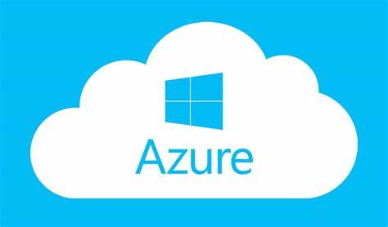
Virtualization - A comprehensive solution
An inarguable need
Tailored to accessibility
Tailored to scalability
Virtualization on Microsoft Azure Platform

Slide 5
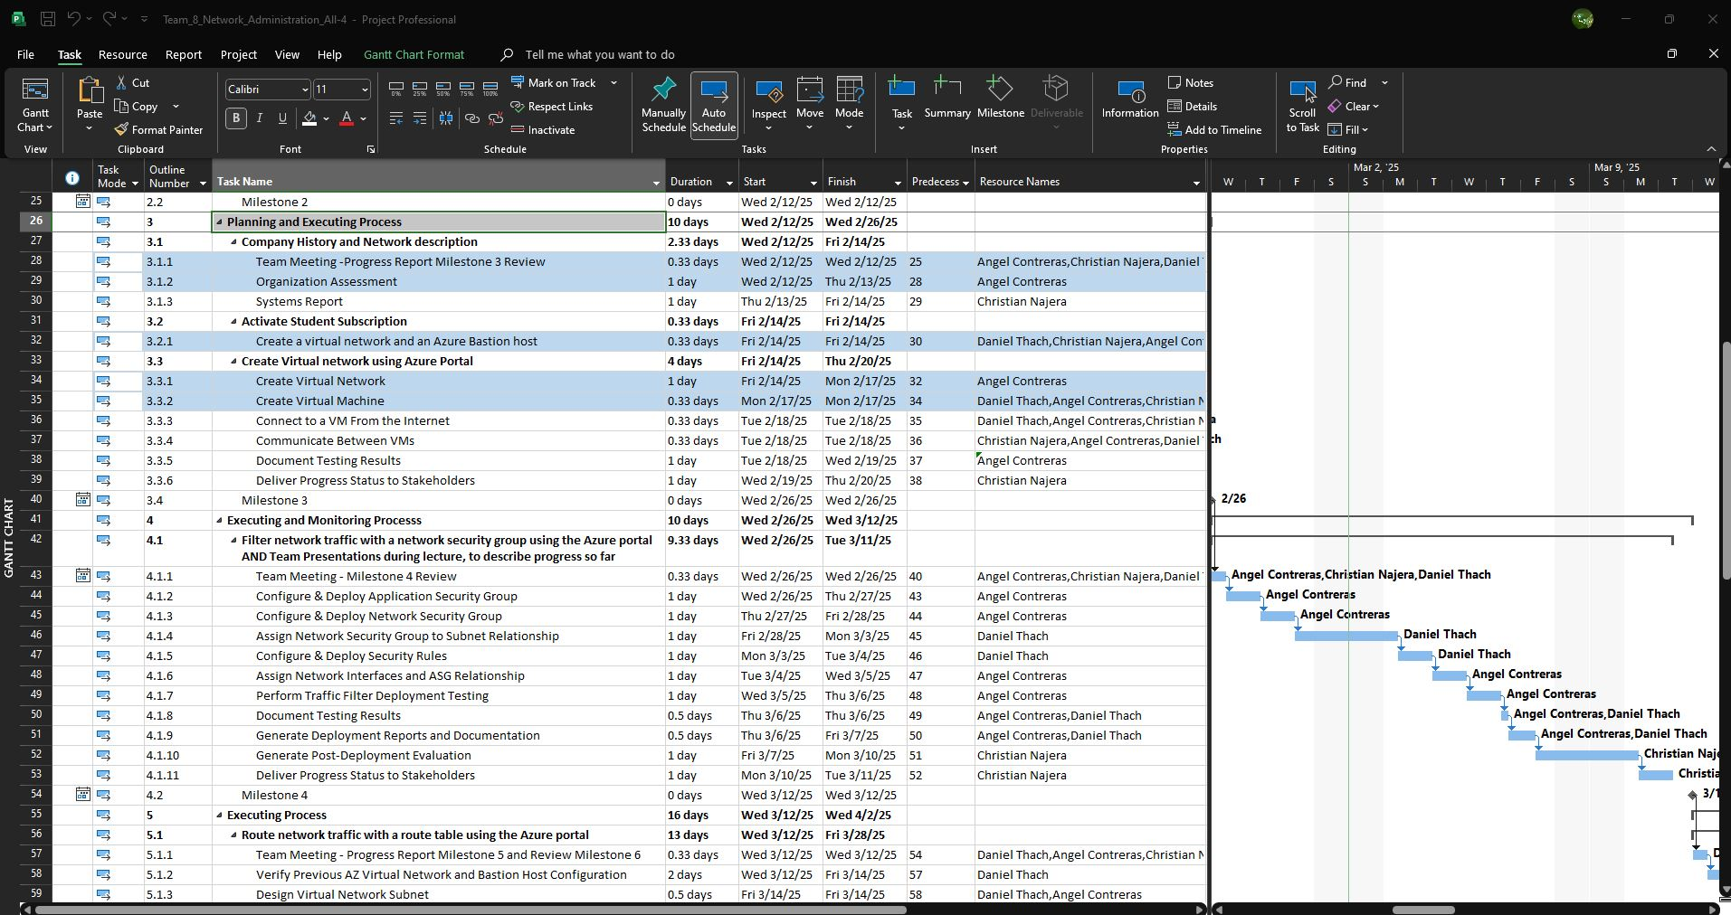
Milestone 3
Planning and Executing Process
Project Scope
Roles & Responsibilities
Virtual Network for Beth Isreal Lahey Health
Notes:
Briefly explain the problem in the business case, from the guy making the mistake to the discoveries of issues that already existed within the network. Then, mention that from our analysis the main concerns for BILH should be accessibility and scalability. Don’t explain as to why yet.

Slide 6
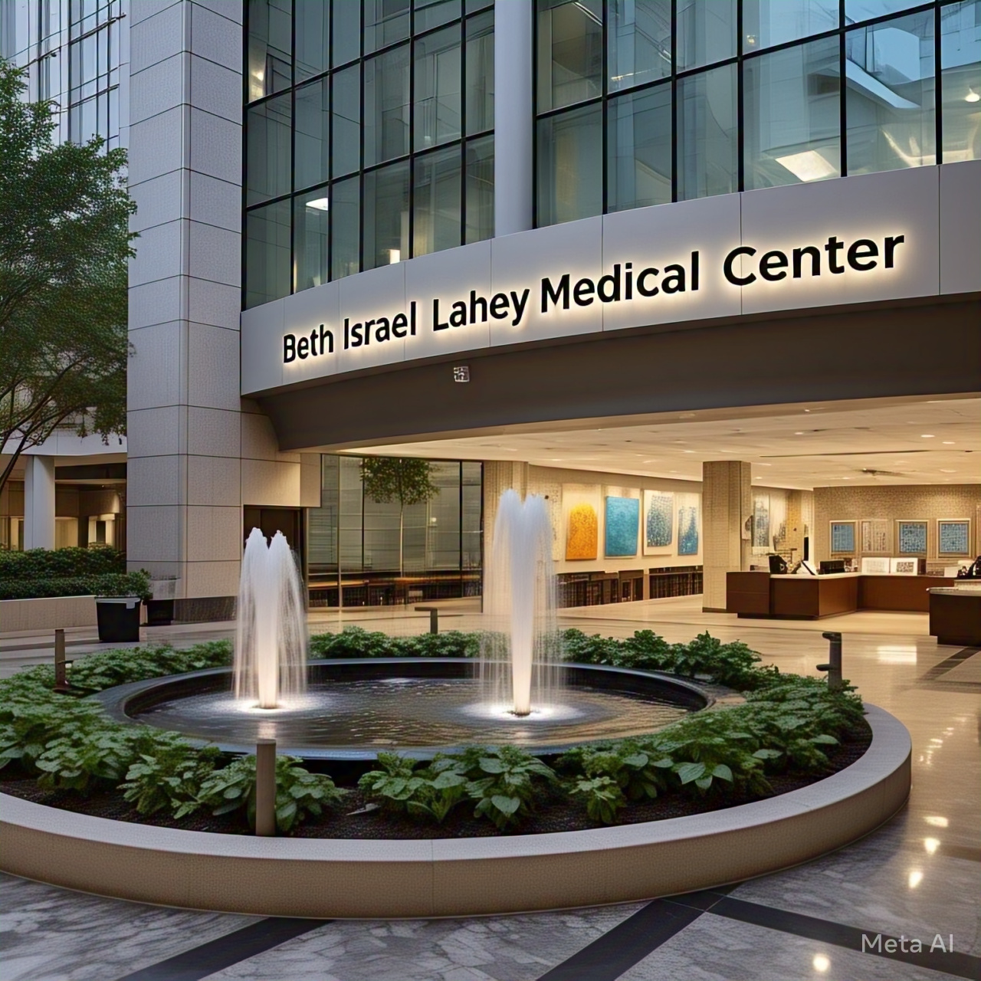
Milestone 4
Executing and Monitoring Process
PowerPoint Outline
Networking Lab Guides
Tested Traffic Filters
Notes:
The business purpose as to why BILH needs this network. Briefly explain what virtualization is and how it meets our two considerations of accessibility and scalability for the business.

Slide 7

Routing Network Traffic with Route Tables

Slide 8
Routing Network Traffic with Route Tables
Creating a NVA
Creating a Route Table
Creating a route
Configuring IP forwarding
Protocol Mapping

Slide 9
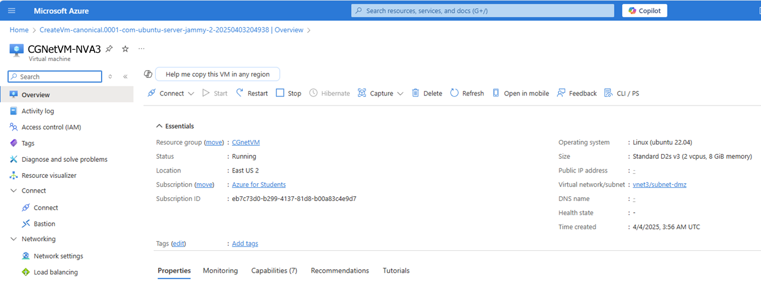
Creating a Network Virtual Appliance

Slide 10
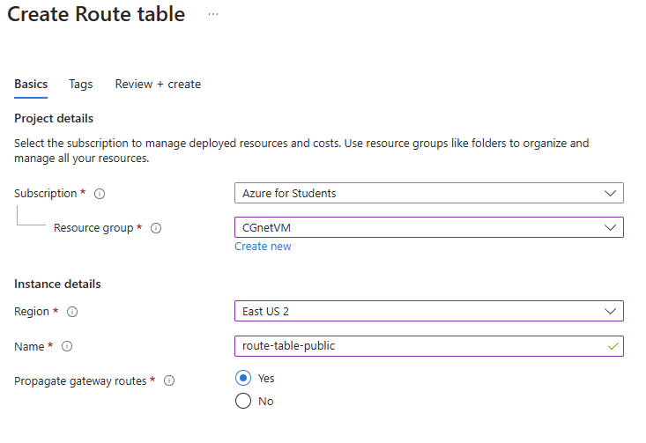
Creating a Route Table

Slide 11
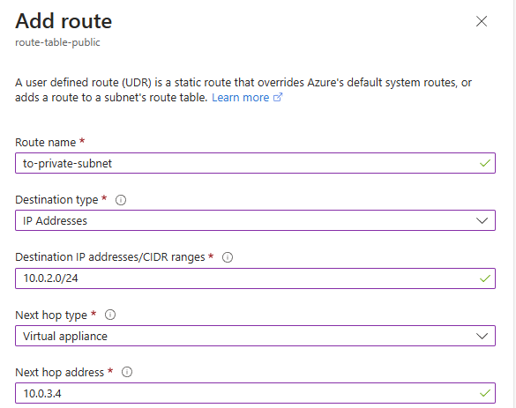
Adding a route

Slide 12
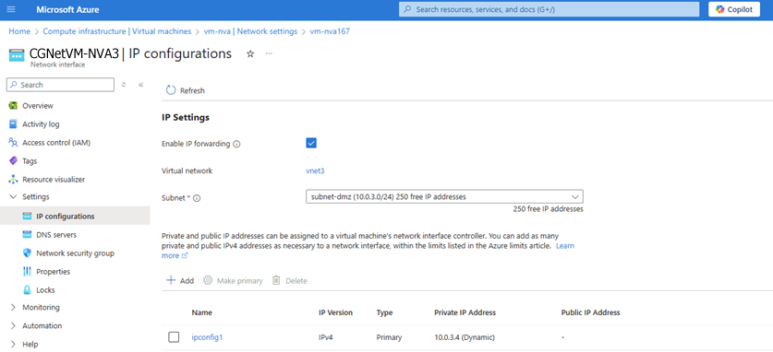
Configure IP Forwarding

Slide 13
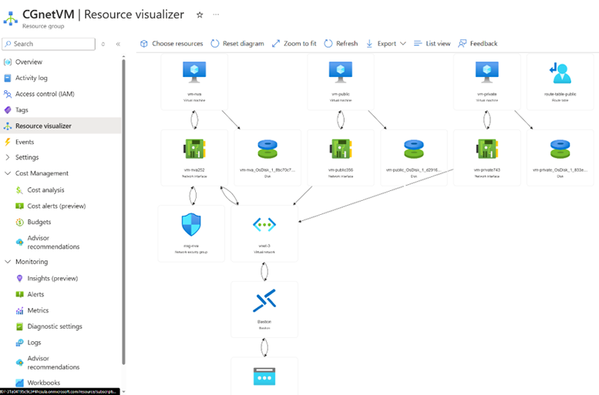
Protocol Mapping
Notes:
Enable ICMP(top image)
Routing test(Bottom image)

Slide 14
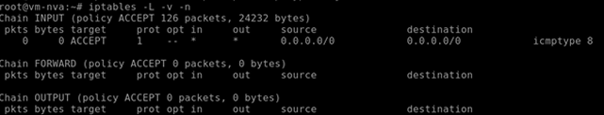
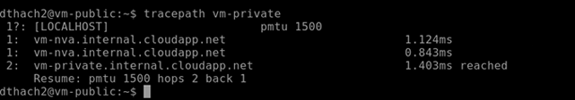
Protocol Mapping
Notes:
Enable ICMP(top image)
Routing test(Bottom image)

Slide 15
Connecting Virtual Networks and Peering

Slide 16
Connecting Virtual Networks
Connecting Virtual Networks via Peering
Testing the Peering connection

Slide 17
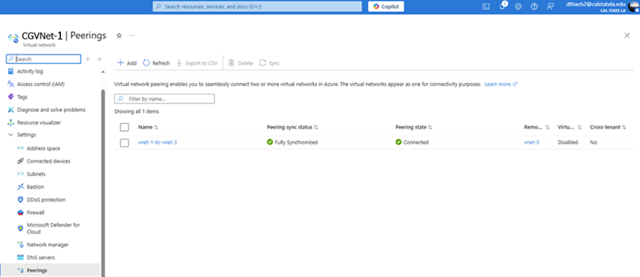

Connecting Virtual Networks and Peering

Slide 18
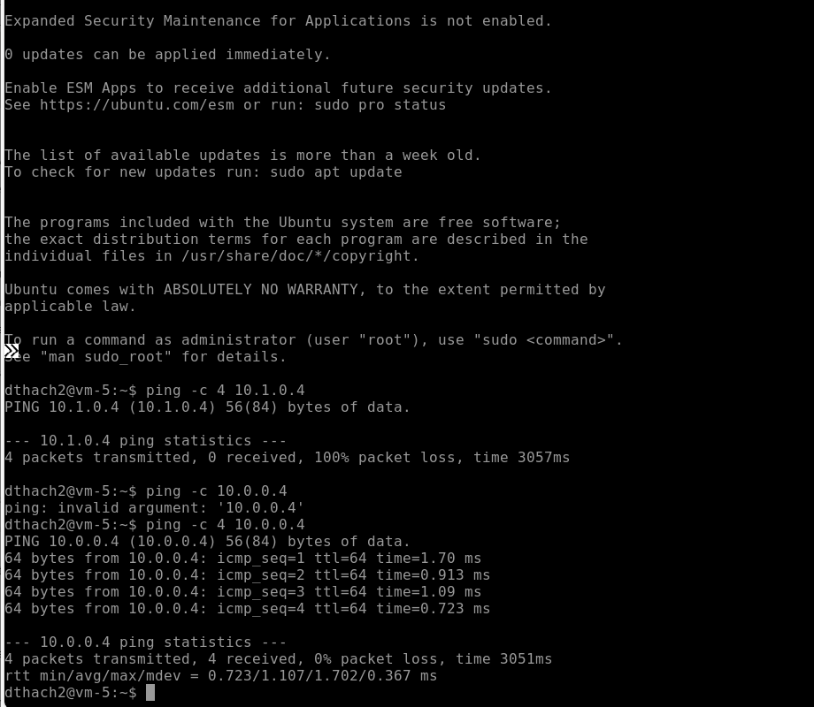
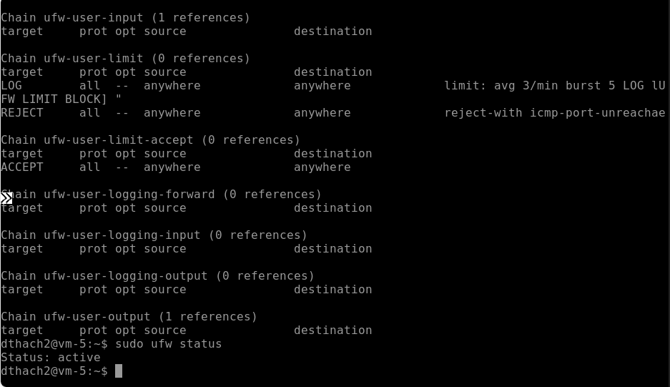
Testing the Peering connection
Notes:
Enabling ICMP Echo request to permit ICMP traffic
We then test the ping to ensure the congfigurations were correct

Slide 19
Takeaways and Considerations

Slide 20
Summary
Designed to support BILH's mission of secure, scalable, and collaborative healthcare.
Built a virtual network with public and private VMs for flexibility and security.
Implemented NSGs and ASGs to manage traffic and protect resources.
Used route tables and NVAs to control traffic flow securely.
Tested connectivity and routing to validate configurations.

Slide 21
Considerations
Balance between accessibility and security in VM deployment.
Complex configuration of NSGs, ASGs, and routing requires accuracy.
Compliance with healthcare regulations requires ongoing updates.
Early planning is essential for future scalability and integration.

Slide 22
QUESTIONS?

Slide 23
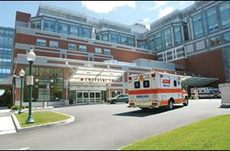
This Harvard Business School case study examines CareGroups’ IT infrastructure collapse in November 2002, detailing the events leading up to the outage and the recovery process. They study highlights how a seemingly minor software experiment triggered a catastrophic network failure due to underlying complexities and a lack of up-to-date knowledge. CareGroup, a large healthcare provider, had invested heavily in IT but faced challenges due to decentralized systems and rapid growth. The response involved reverting to paper- based systems, engaging Cisco for expert support, and implementing crucial changes to network management and infrastructure. Ultimately, the incident provided valuable lessons about network configuration, the importance of expertise, and the need for robust backup procedures in critical systems.
asudbring. (2023, May 4). Network security group – How it works. Microsoft. https://learn.microsoft.com/en-us/azure/virtual-network/network-security-group-how-it-works
asudbring. (2024, August 20). Tutorial: Filter network traffic with a network security group (NSG). Microsoft. https://learn.microsoft.com/en-us/azure/virtual-network/tutorial-filter-network-traffic?tabs=portal
GeeksforGeeks. (2022, July 22). Fundamentals of virtual networking. https://www.geeksforgeeks.org/fundamentals-of-virtual-networking/
Khan, A. (2023, March 6). How network security groups filter network traffic. LinkedIn. https://www.linkedin.com/pulse/how-network-security-groups-filter-traffic-ali-khan-/
KumudD. (n.d.). Route network traffic – Tutorial – Azure Portal. Microsoft. https://docs.microsoft.com/en-us/azure/virtual-network/tutorial-create-route-table-portal
Massachusetts Health Policy Commission. (2018). Final CMIR report – Beth Israel Lahey Health – Executive summary. https://www.mass.gov
McFarlan, F. W., & Austin, R. D. (2005). CareGroup (Case No. 9-303-097). Harvard Business School.
Microsoft. (2024a). What is Azure Virtual Network? https://learn.microsoft.com/en-us/azure/virtual-network/virtual-networks-overview
Microsoft. (2025a). What is a virtual machine and how does it work | Microsoft Azure. https://azure.microsoft.com/en-us/resources/cloud-computing-dictionary/what-is-a-virtual-machine/?msockid=1b50d6747d616ea30770c3467cf36f18
Samanro. (n.d.). Microsoft cloud architecture models – Enterprise resource planning. Microsoft. https://docs.microsoft.com/en-us/microsoft-365/solutions/cloud-architecture-models?view=o365-worldwide
Susnjara, S., & Smalley, I. (2024, March 3). What is a virtual machine (VM)? IBM. https://www.ibm.com/think/topics/virtual-machines
REFERENCES
Notes:
Just a history and presenting the subject of our business case, you can pretty much just read the bullet points.

